Slide 1

Ethics & communication project introduction
How can data science be used for the good of society?
Data Analysis course
DE15
João Neto

Slide 2


How can data science be used for the good of society?
Driving Innovation to Help the Environment
Healthcare
Security
Assist learning
Help the energy industry

Slide 3
How can data science be used for the good of society?
Security
An urban police department created statistical incident analysis tools to help officers understand when and where to deploy resources in order to prevent crime. The data-driven solution creates reports and dashboards to augment situational awareness for field officers.
Source: https://www.ibm.com/cloud/learn/data-science-introduction#toc-data-scien-xeu8dq_g
Data should not be used to know more about a person individually
Data Analytics in Mental Healthcare
Solution to seniors to live independently for longer
Healthcare
The information must be used for what was proposed
There are numerous mobile clinical devices which are established in patients’ personal body networks and medical devices (…) Big data collected from wearable tracking devices and electronic records help to store accumulating and extensive amounts of data.
Source: https://doi.org/10.1155/2020/2024160
(…) Combining sensors, machine learning, analytics, and cloud-based processing, the system monitors for unusual behavior and alerts relatives and caregivers (…).
source: https://www.ibm.com/cloud/learn/data-science-introduction#toc-data-scien-xeu8dq_g

Slide 4
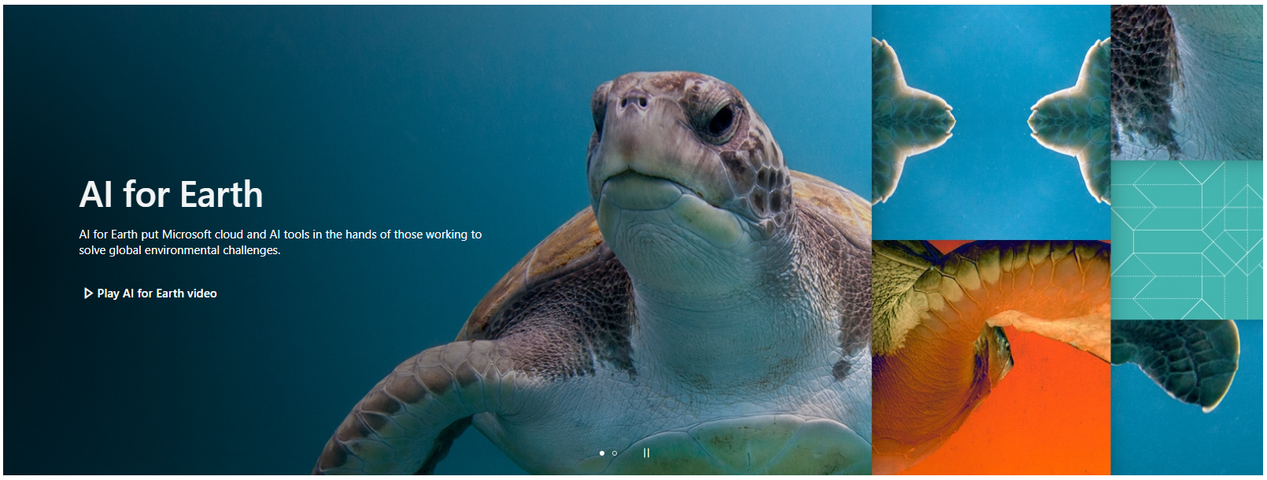
How can data science be used for the good of society?
Innovation for help the Environment
Using AI for Ocean Cleanup, Wildlife Protection, and More
“Microsoft is giving scientists and research organizations access to AI and machine learning technology through its AI for Earth initiative. Launched in 2017, AI for Earth awards grants to support projects in the areas of climate, agriculture, biodiversity, and water.”
Source: https://medium.com/rs21/4-ways-data-science-is-driving-innovation-to-help-the-environment-348f79bc44c
Where comes from our data base? Source and purpose matters.
Assist learning
Using data science to support people with learning disabilities
“(…) We can support them in living healthier and happier lives through data science and analytically evidenced insight that drives the interventions.”
Source: https://www.cerner.com/gb/en/industry-perspectives/using-data-science-to-support-people-with-learning-disabilities

Slide 5

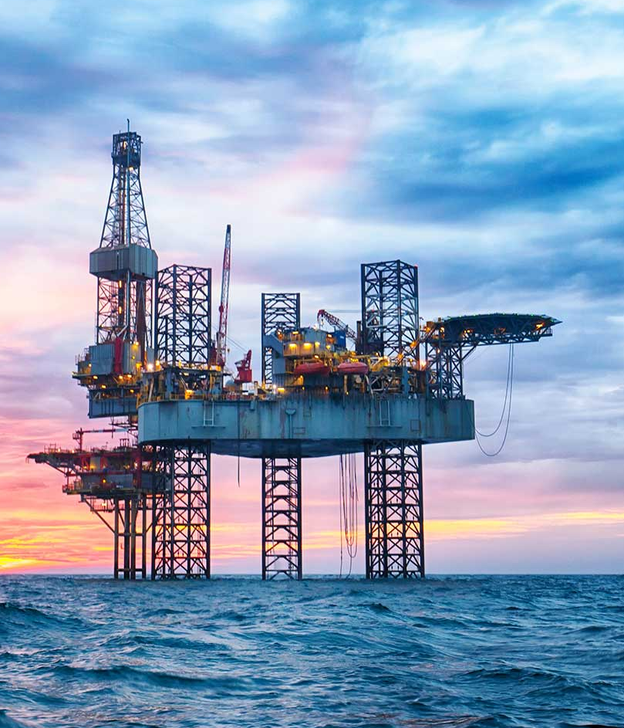
How can data science be used for the good of society?
Efficiency in energy industry
Solar and wind energy management
https://moderndiplomacy.eu/2022/03/30/the-impact-of-data-science-on-the-energy-industry/
Wind and solar do not produce enough power when natural resources are scarce….
Fossil fuels
Solar
Wind
In oil energy industry to make prediction that has been lead to :
Source: https://www.airswift.com/blog/data-science-in-energy
Increase safety and prevent accidents, predicting the maintenance requirements for field equipment.
Reduce operational costs and optimize production processes, reducing the downtimes.
(…) Data analysis and computational models can determine the highs and lows of power usage, as well as when there is a surplus (…)
Limit the amount consumed and carbon pollution
Assist regulators in making more informed and sustainable energy-comprehensive decisions
Reduce power waste resulting in cost savings

Slide 6
How can data science be used for the good of society?
Conclusion
The data science could be relevant for human development and well being: New ways of doing what is already exist; Increase efficiency; Increase security; Develop innovated solutions that help humanity to have better conditions of life; Could help people with disabilities to learn.
Although data science is used for societal benefit, ethics topic should never be undervalued.
The data has been used for what were acquired?
Is still needed the data we acquired?
Data comes from known and confidente source?
yes
No
yes
No
yes
No
It is not supposed
The data should be mantained just while was needed
How trustworthy will be our insights?
How we face bias and proxy problem?
We should guarantee our image as professionals and the company that we work for.

Slide 7
How can data science be used for the good of society?
?
Is my opinion relevant in data science even when are matters relevant for well being of society
In my opinion no.
Thank you for your attention
João Neto

